Slide 1
Equipment event logs downloads

Slide 2
INTRODUCTION
This document is meant to guide teams in the process of downloading/exporting event logs from common units/ systems in our network.
We are to cover;
-Delta BBS
-Eltek
-TP48200A
-Dead sea controllers
Logs are important for they show happenings (events) in the performance of the unit, this helps when trouble shoot after occurrence of a fault.
Note;
It is advisable to have the time and date set well for all equipment to ease matching of events.

Slide 3
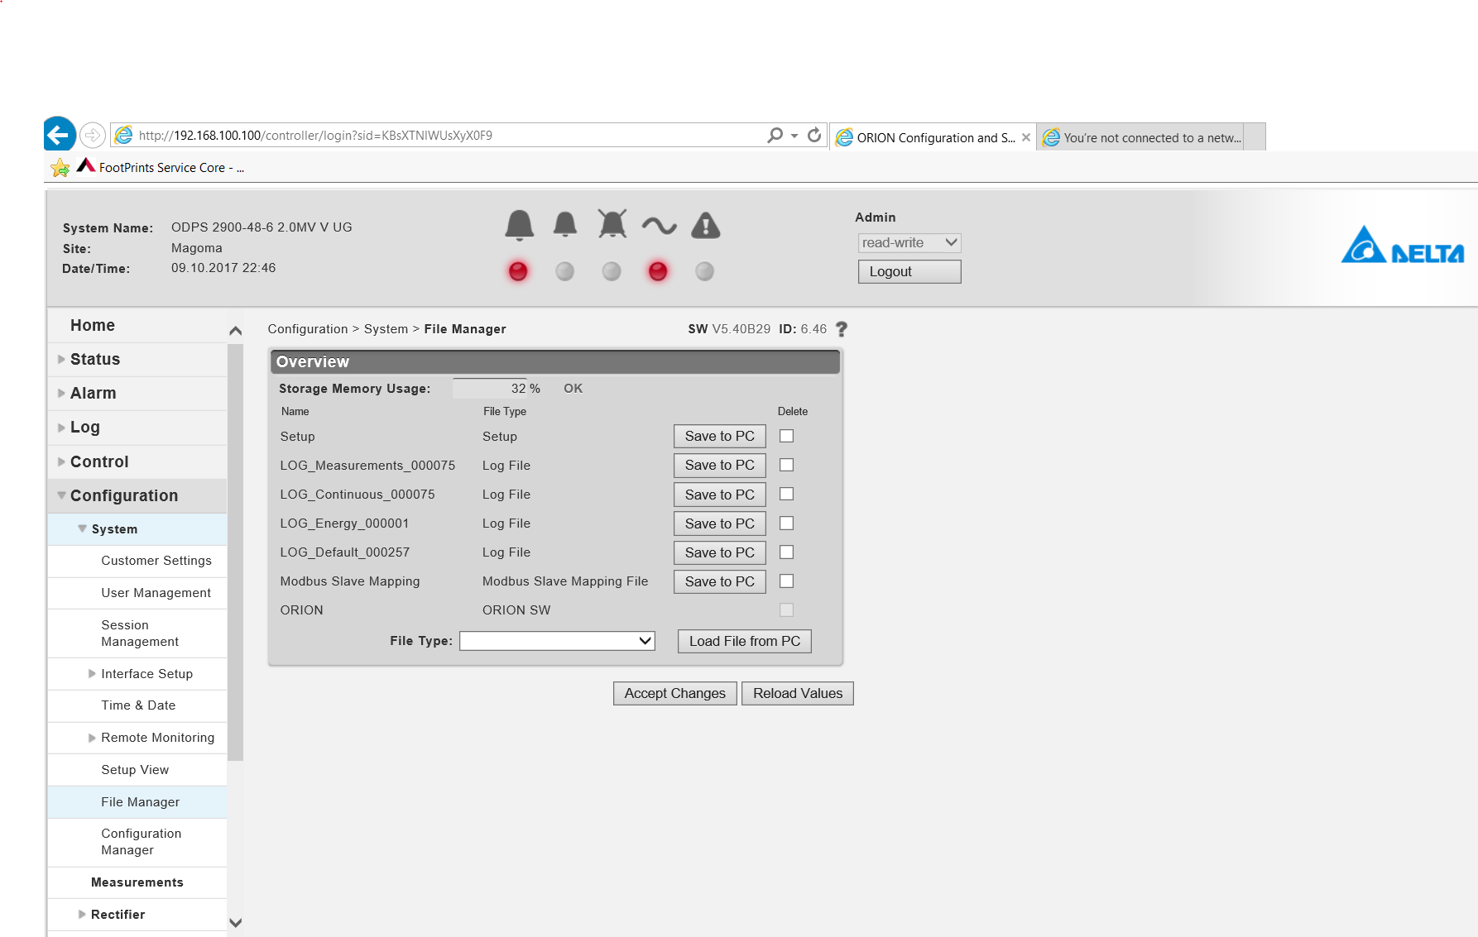
Delta (orion and PSC3 controllers)
We shall not go through the process of logging into the different BBSs, I believe this is known to everyone.
Orion;
Logs are pulled from file manager, below are the steps;
Configurations system file manager

Slide 4
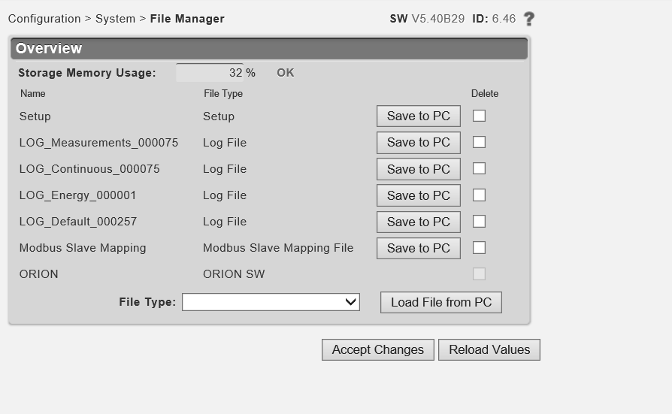
.
A click on save to PC pulls the logs for the selected file. It could be continuous, energy, etc…..
For proper storage , it is advisable to create a folder into which all the logs will be saved.
Note that for all prompts, select save for the files to be moved to the folder.

Slide 5
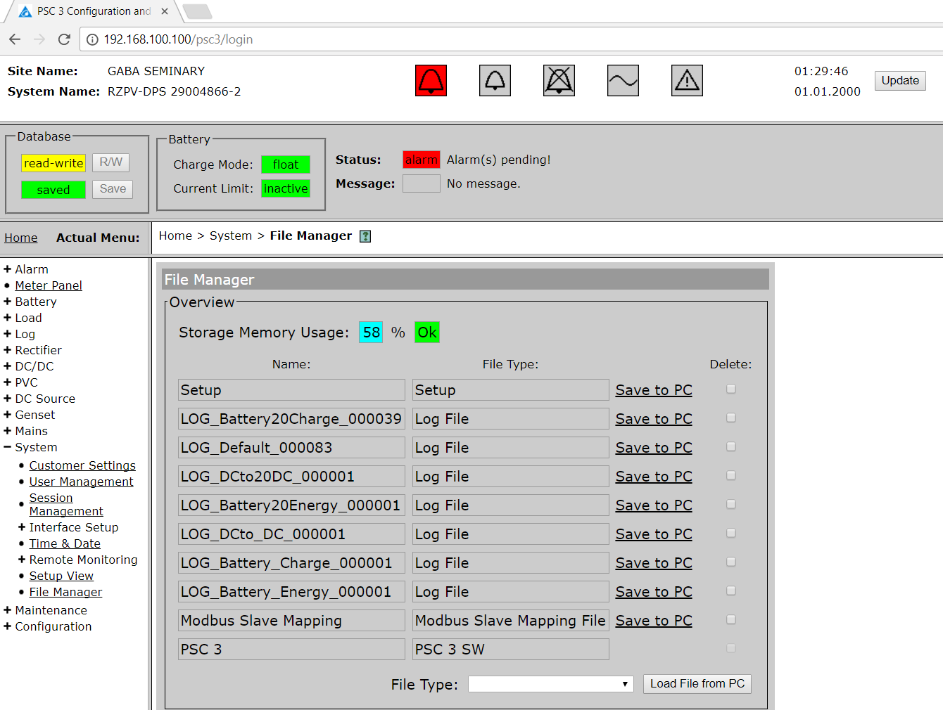
Psc3 controller;
Its is almost the same way, a few steps change here;
At the home page, select system then file manager after.
Home system file manager

Slide 6
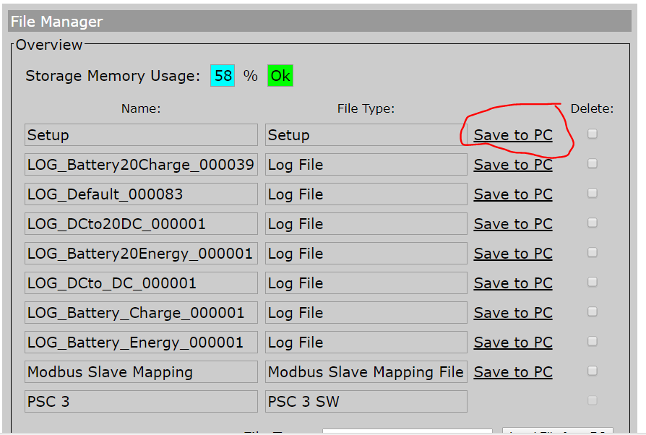
.
A click on save to pc pulls logs for the selected event
Just like the orion controller, its advisable to save all logs in one folder (you can call it the name of the site)

Slide 7
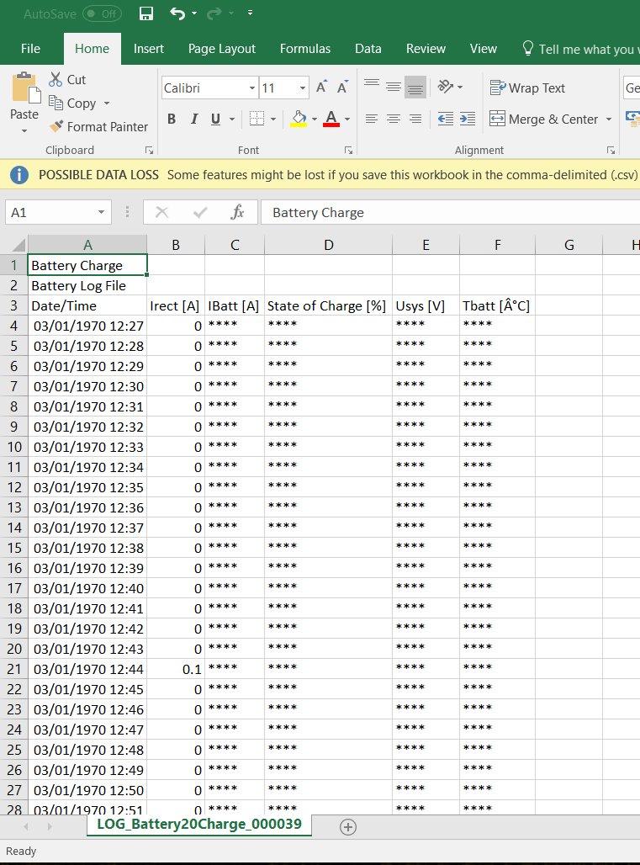
.
Its better to save logs in excel format for proper interpretation;

Slide 8
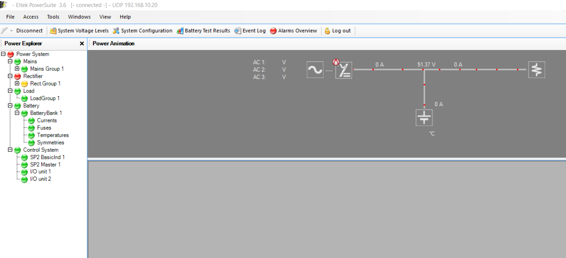
ELTEK;
This bbs system keeps all logs under one file, it is up to the one downloading to pick say latest 1000, 3000 or pick all.
The steps are clear, click on event log on the main task bar of the web interface.

Slide 9
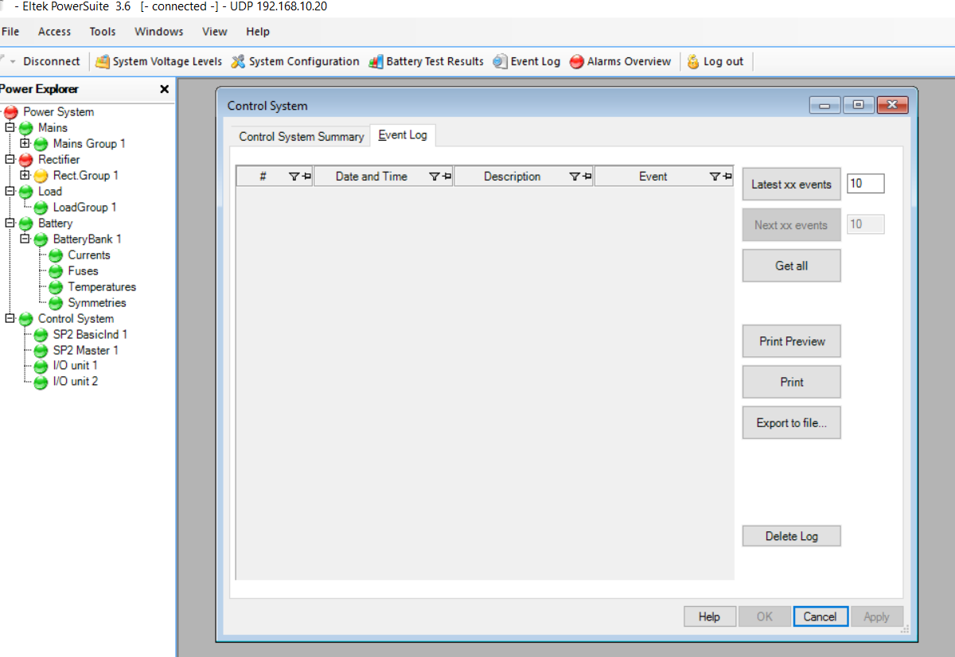
.
This leads you to another page;

Slide 10
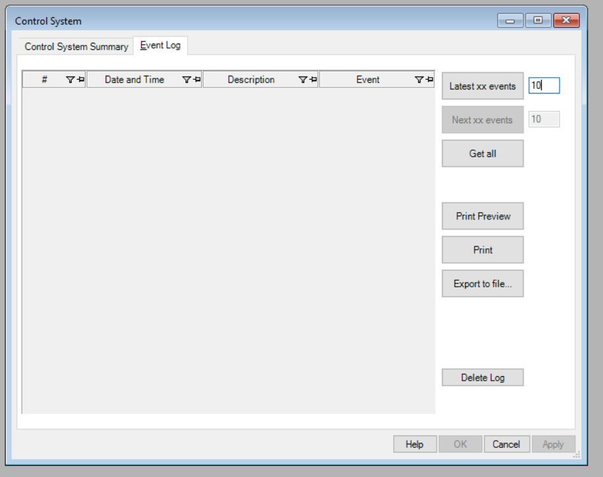
.
Here we can select and number of events starting with the latest, however it is advisable to get all.

Slide 11
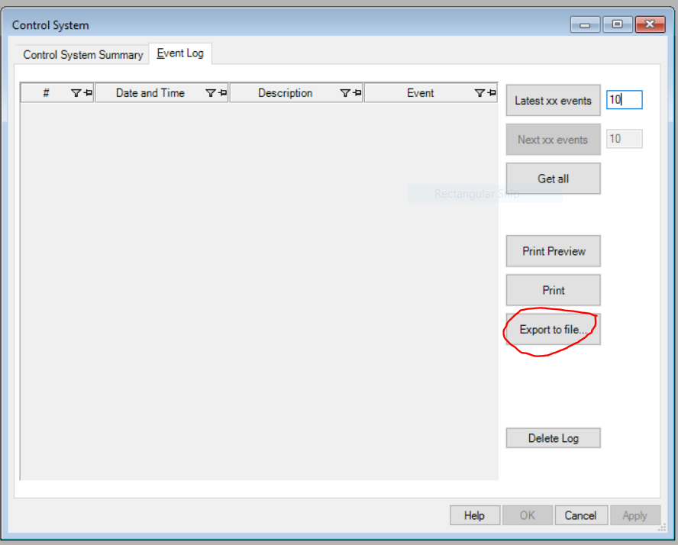
.
After this , we export all to the excel sheet

Slide 12
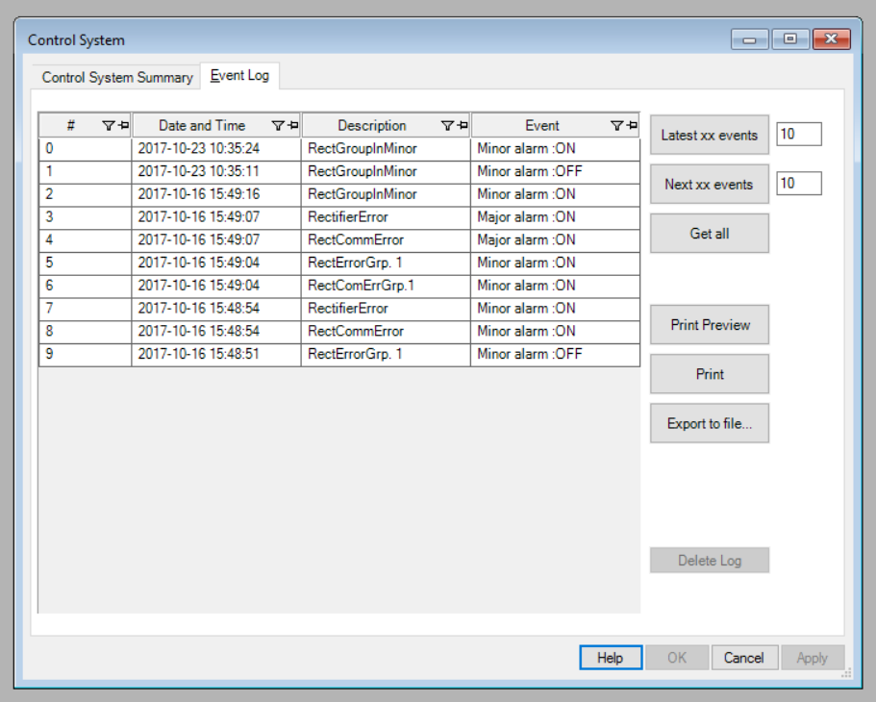
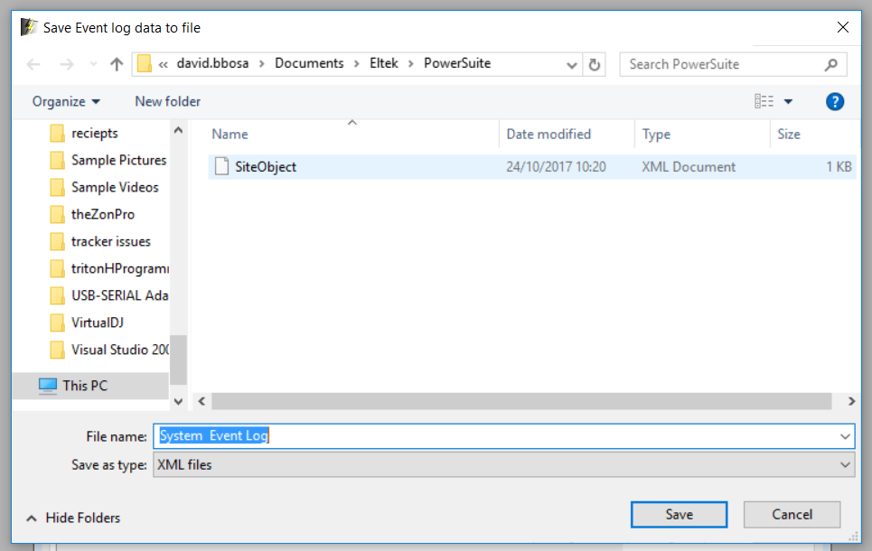
.
A sample of the exported logs will appear as below;
After, this file is saved.

Slide 13
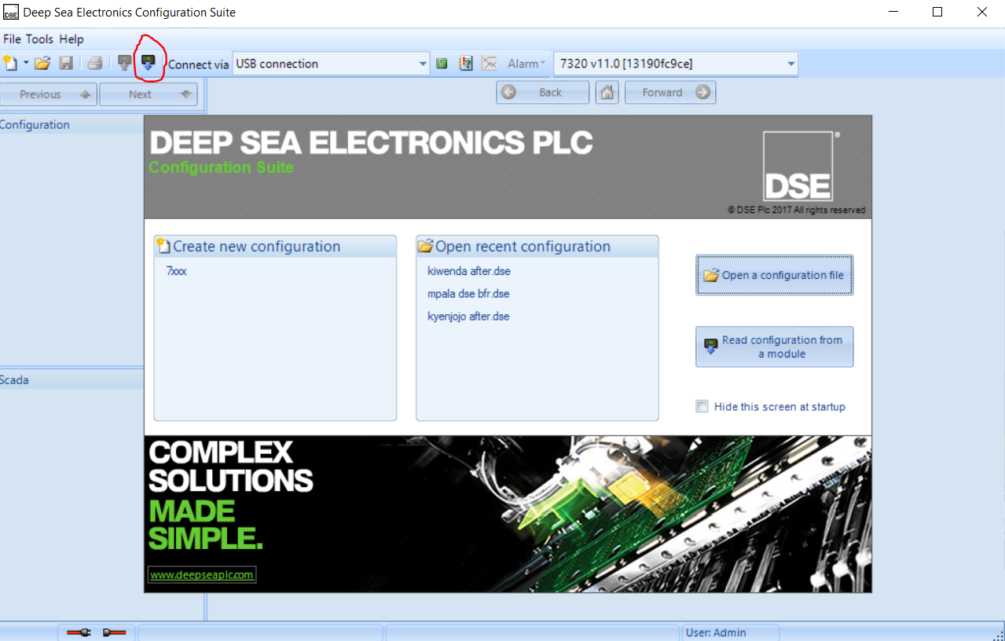
Deepsea controller;
The team should have an updated dse SW version to be able to log onto the panel and pull logs.
After starting dse sw, click read from module;

Slide 14
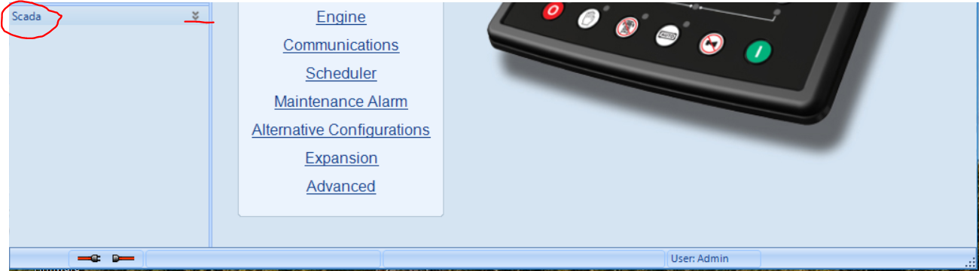
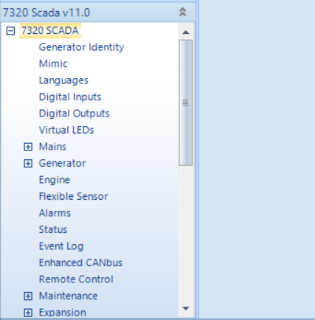
.
Click on the arrows pointing down (on the right of scada)
A list of controls shows-up

Slide 15
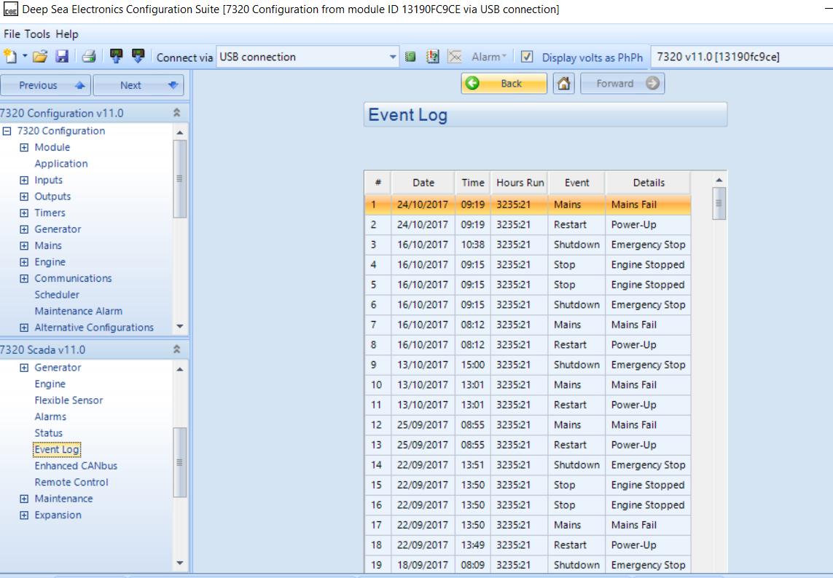
.
Selection of event log generates a list of events as below,

Slide 16
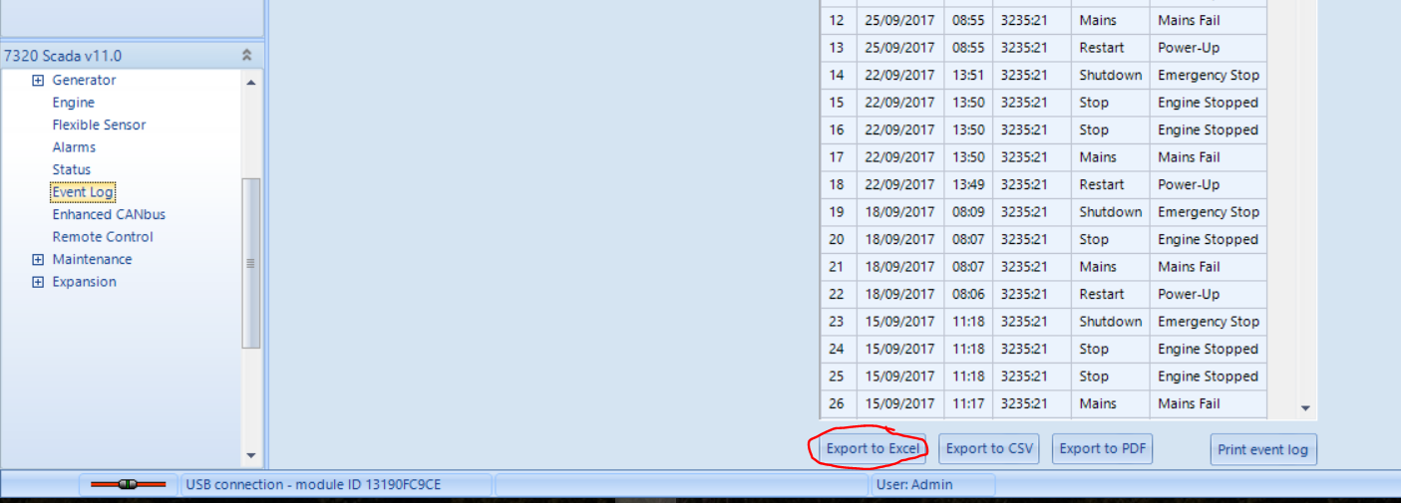
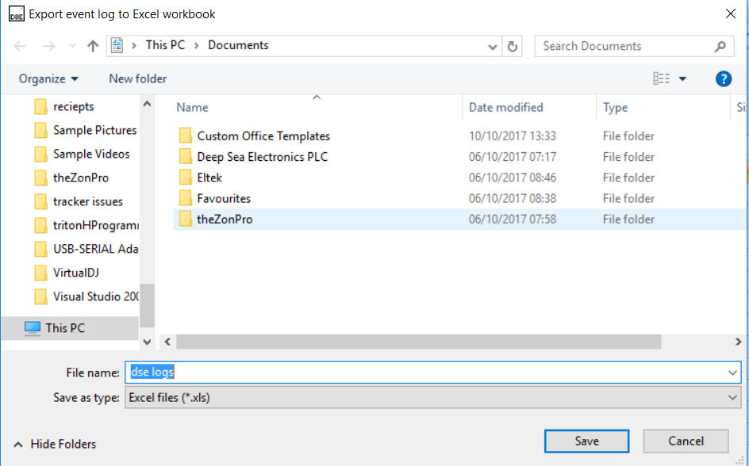
.
At the bottom of the list, click export file and save doc in excel format
Save as;

Slide 17
TP48200A
For this rectifier system we can query and export different events separately, the logs which can be generated include;
-Historical alarms
-Performance data
-operation records
-Battery test records.
Historical Alarms
This allows us to query alarm information about one or all devices base on device types.
How to access historical alarms;
After logging in go to query on the main tab, a list of events to query is generated, select historical alarms.

Slide 18
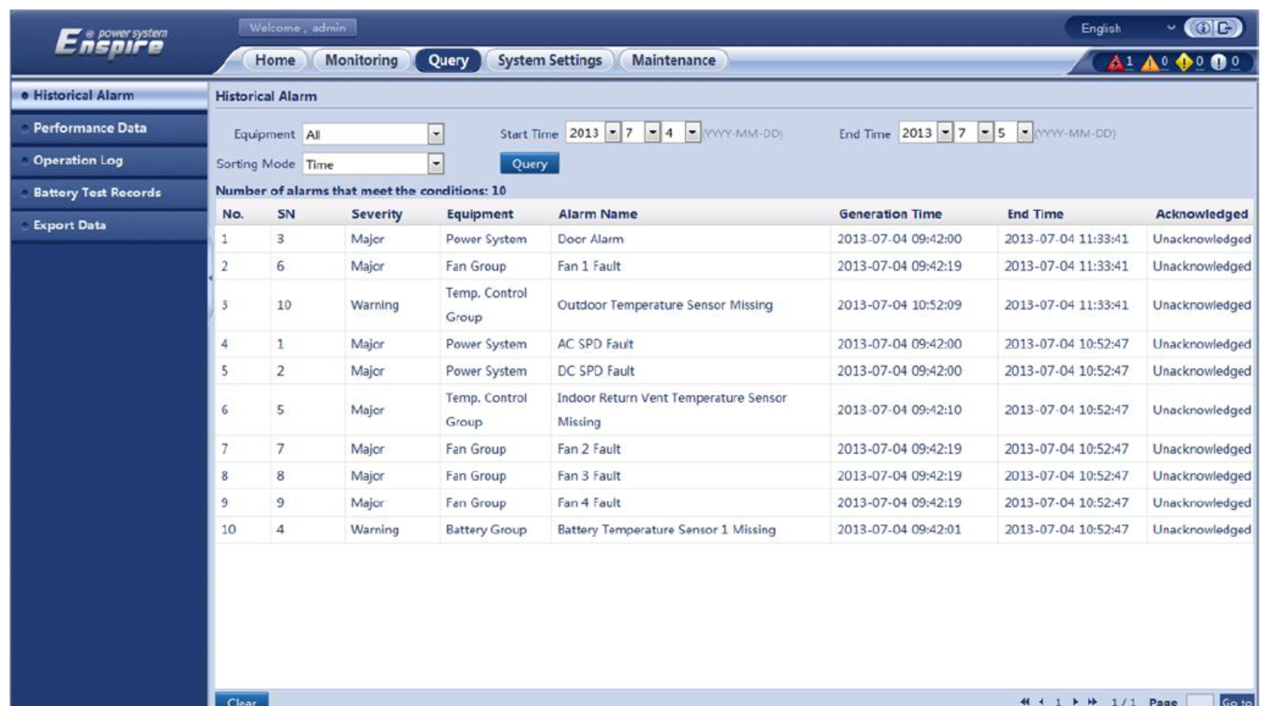
.

Slide 19
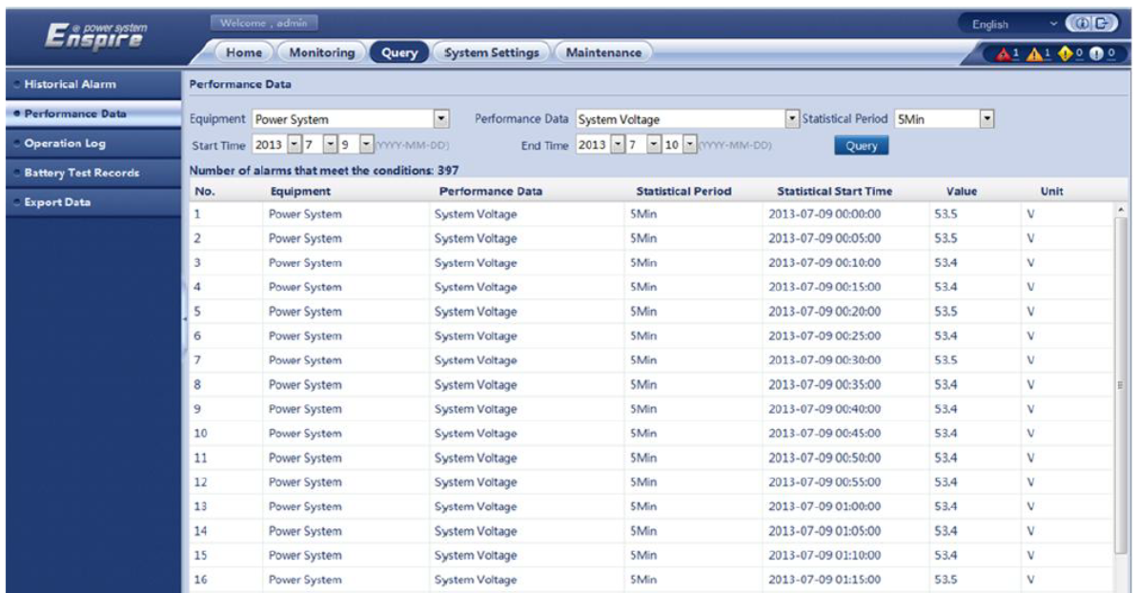
Querying performance data;
Performance data allows us to query systems parameters like ambient temps, system voltages and battery parameters based on device type.
Again we go to query on the main tab then select performance data.

Slide 20
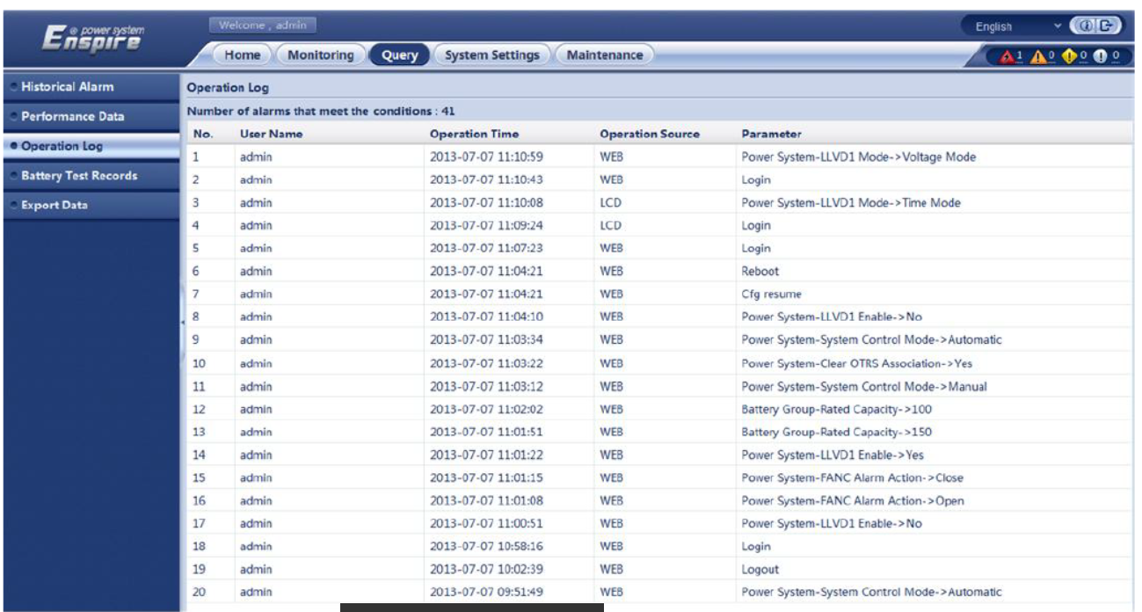
Operation records/logs.
This allows us to query historical operation records of users. This shows login records and actions done by different user e.g. changing parameters.
To access this, select query on the main tab and the choose operation log as below;

Slide 21
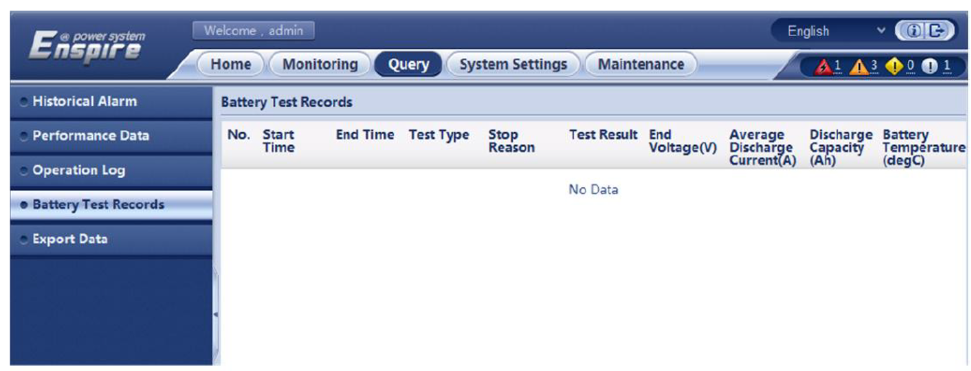
Battery test records;
This shows records after doing any battery test on the system.
Select query on the main task bar then choose battery test records.

Slide 22
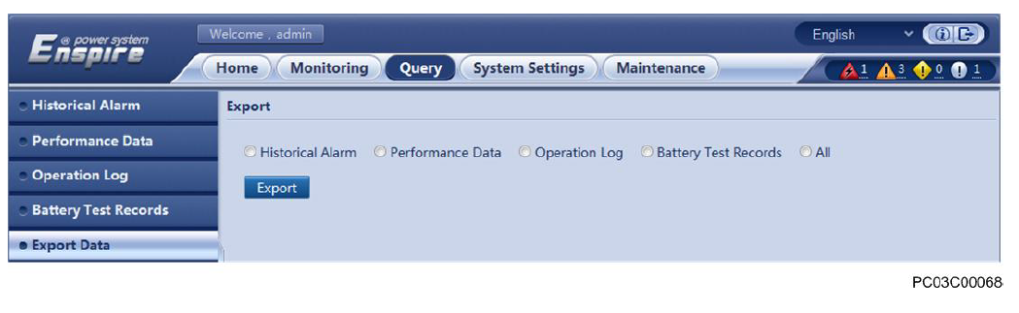
Exporting logs
After querying the events, you may need to export the information. This is also possible and you can decide to export all or on single event .
Still on the main tab, select query. At the bottom of the list you find an option to export data.
You can select an event to export or choose all. Click Export to download the logs.
Excel format is the best for easy interpretation.

Slide 23
Thank you.

